Slide 1
Kubernetes
By
Arun

Slide 2
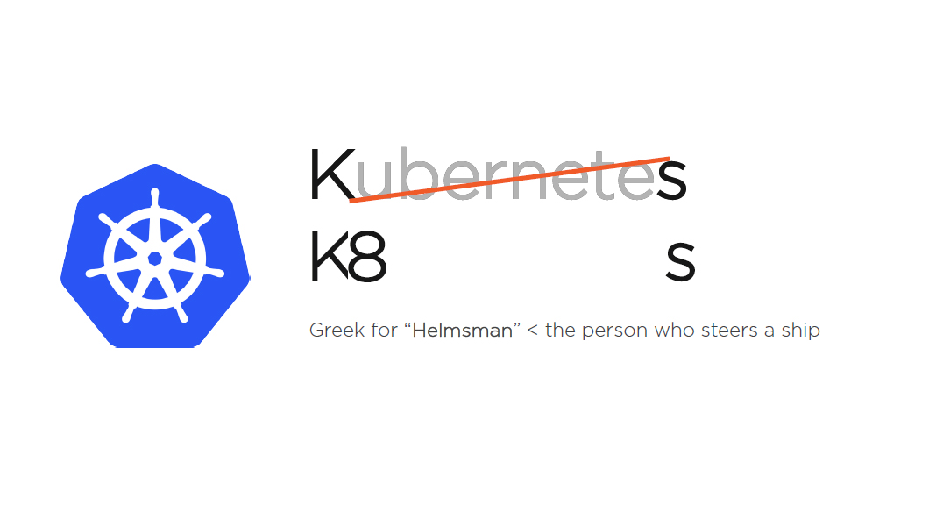

Slide 3
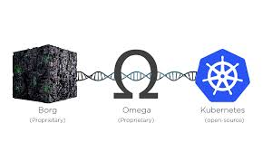

Slide 4
Donated to CNCF
Initial Release = 7th June 2014
Current version = 1.16 (Sept 2019)
Go
Apache License 2.0
November 18 – 21 (2019) | San Diego Convention Center, San Diego, California
github.com/kubernetes/kubernetes
Microk8s = Fast Light Kubernetes
Ks3 = Light Weight Kubernetes
Minikube Single Node Kubernetes Cluster

Slide 5
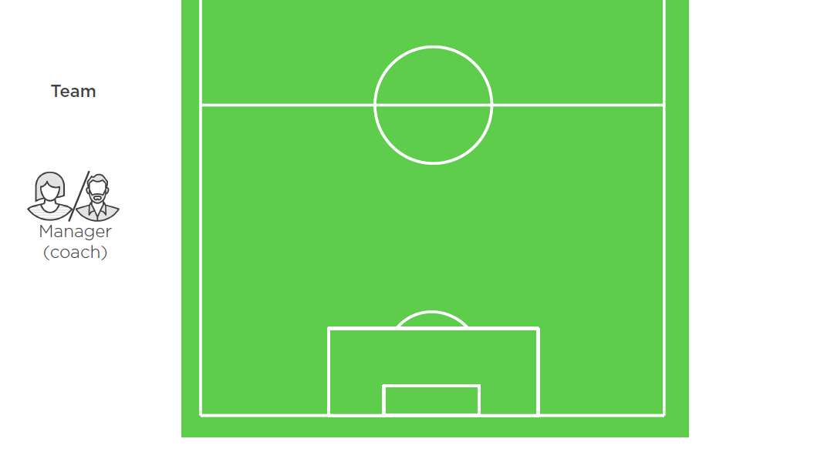

Slide 6
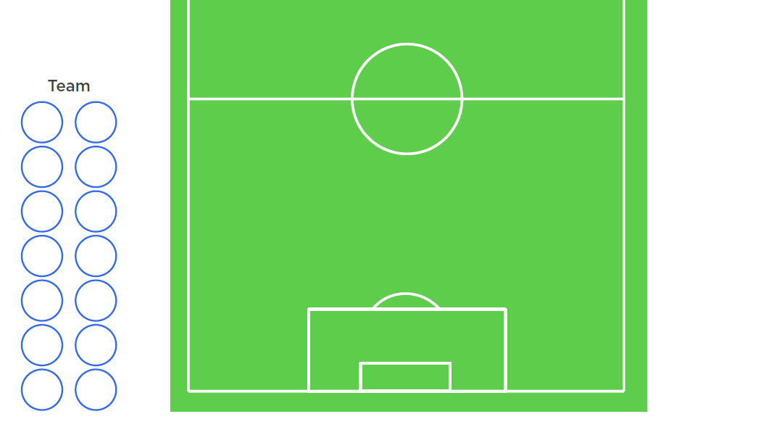

Slide 7
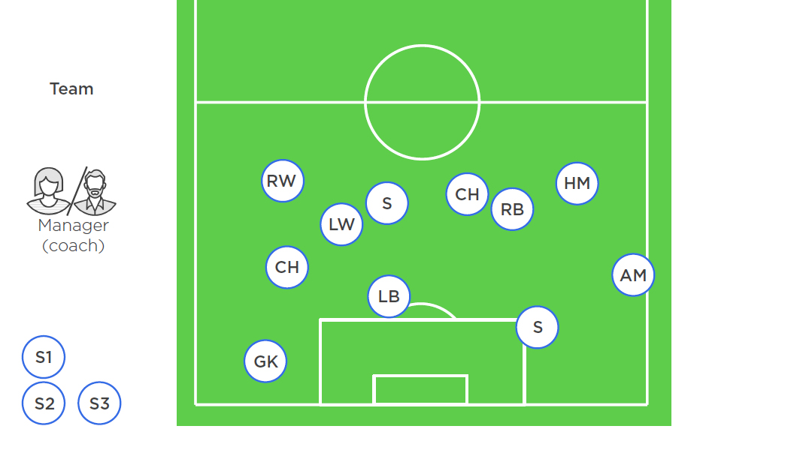

Slide 8
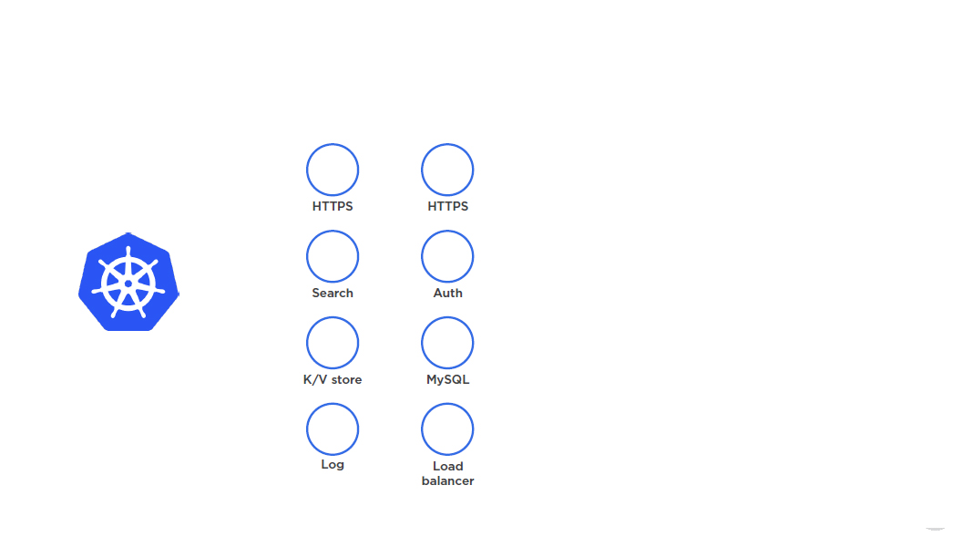

Slide 9
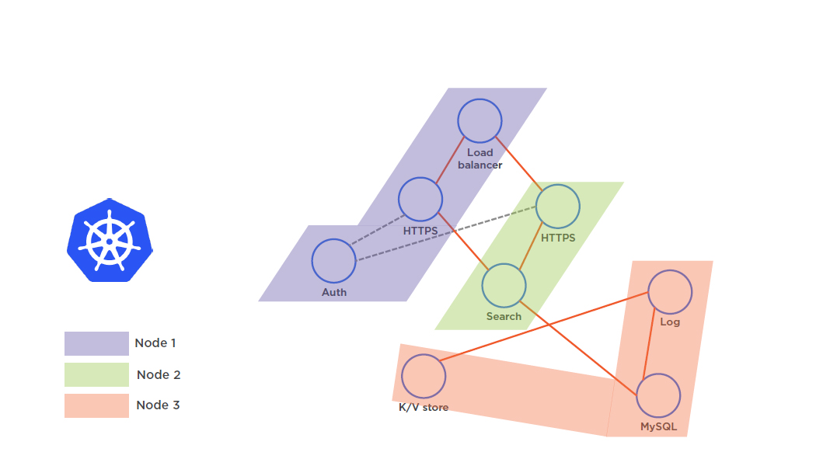

Slide 10
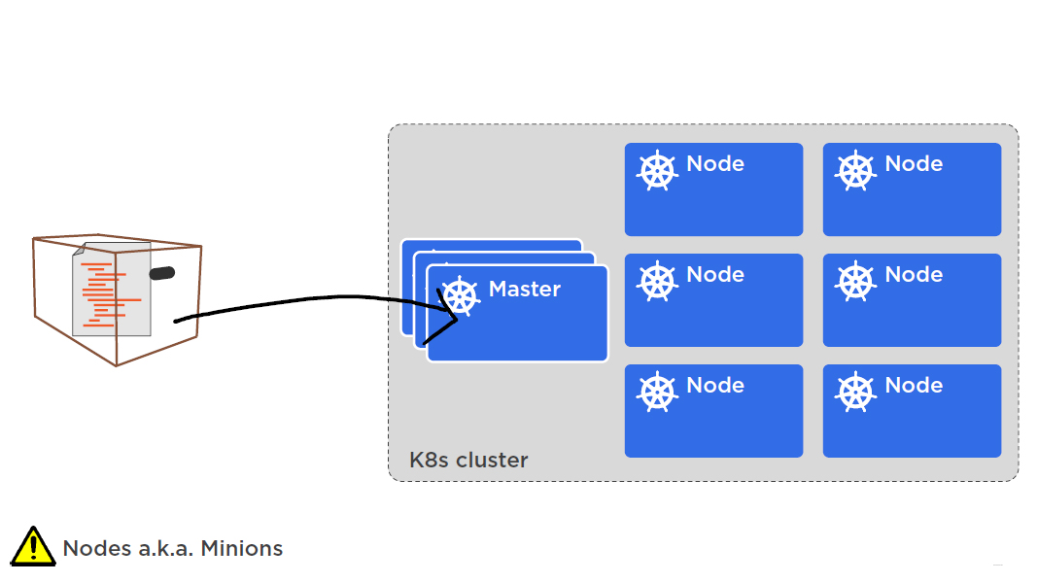

Slide 11
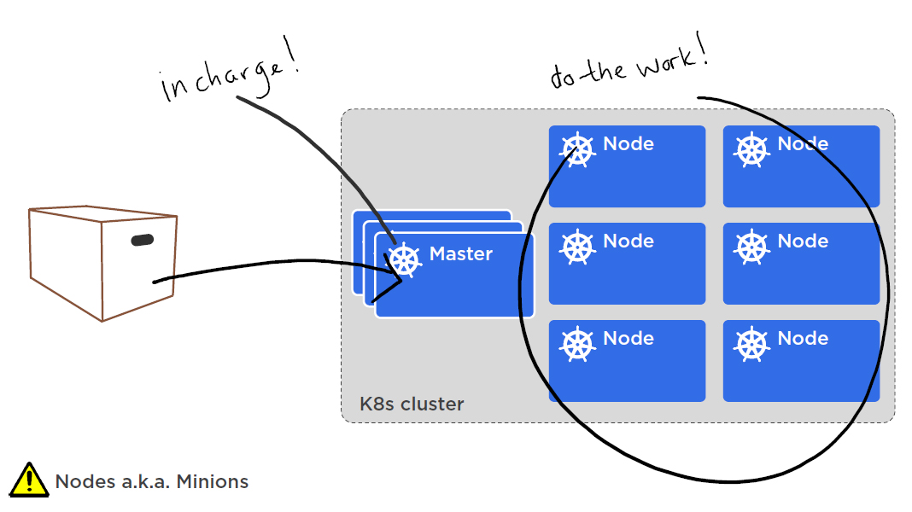

Slide 12
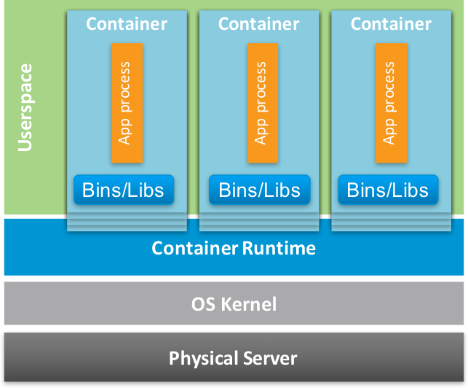

Slide 13
Docker (https://docs.docker.com/engine/)
Rocket (rkt) = CoreOS (https://github.com/rkt/rkt)
LXD (Canonical ltd)

Slide 14
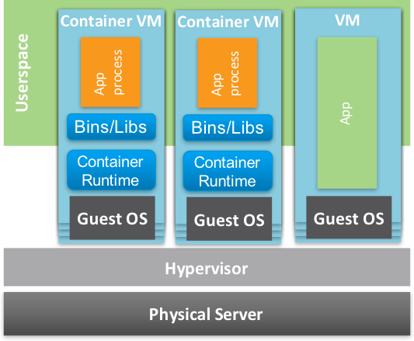

Slide 15
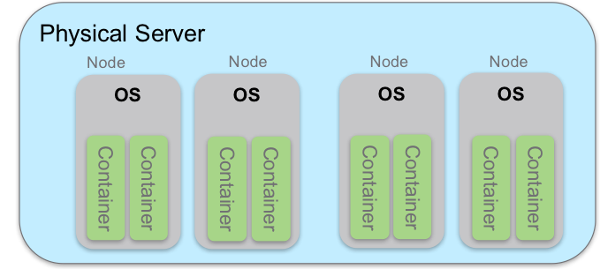

Slide 16
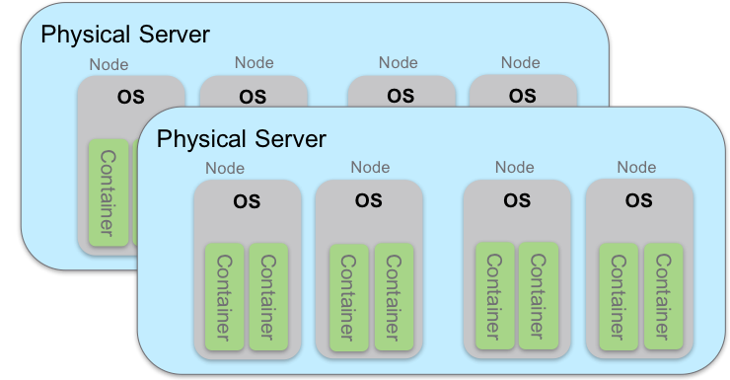

Slide 17
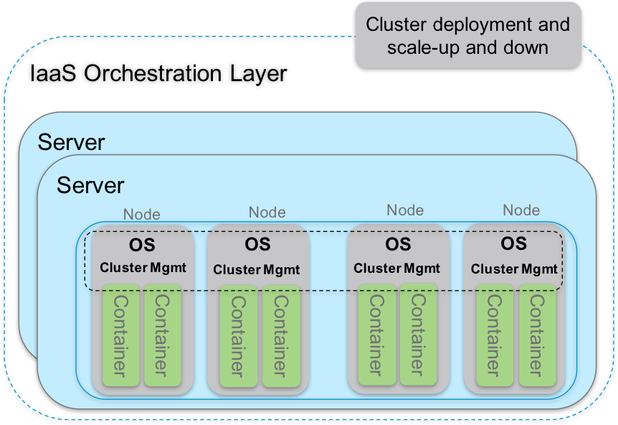

Slide 18
Kubernetes
SWARM
MESOS

Slide 19
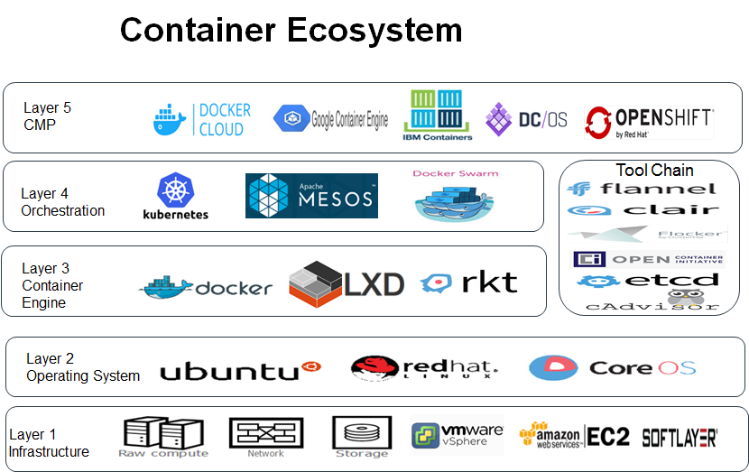

Slide 20
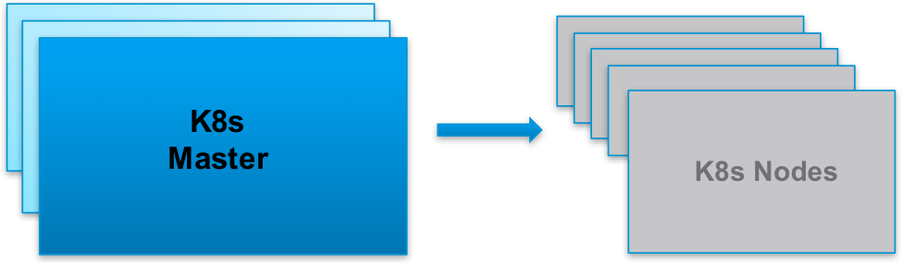

Slide 21
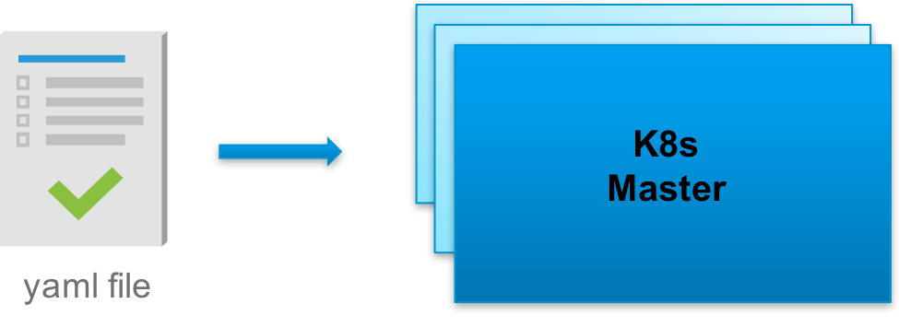

Slide 22
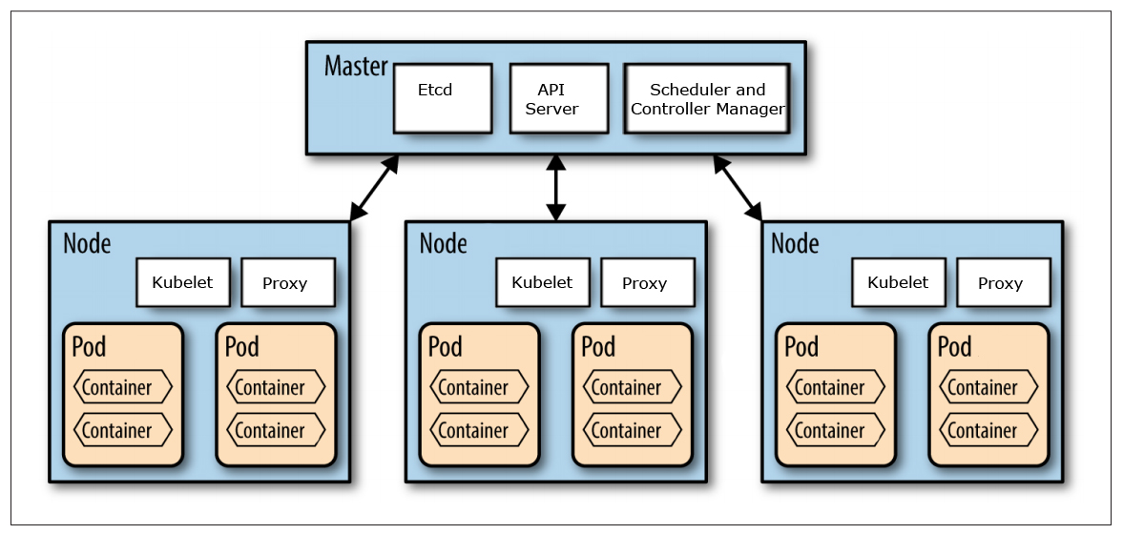

Slide 23
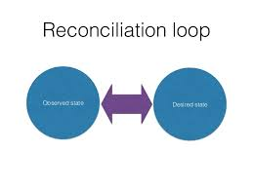

Slide 24
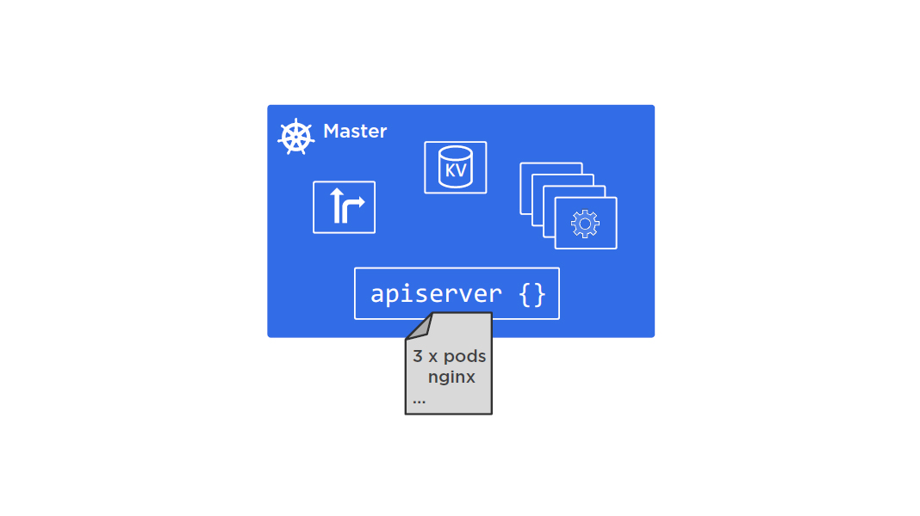

Slide 25
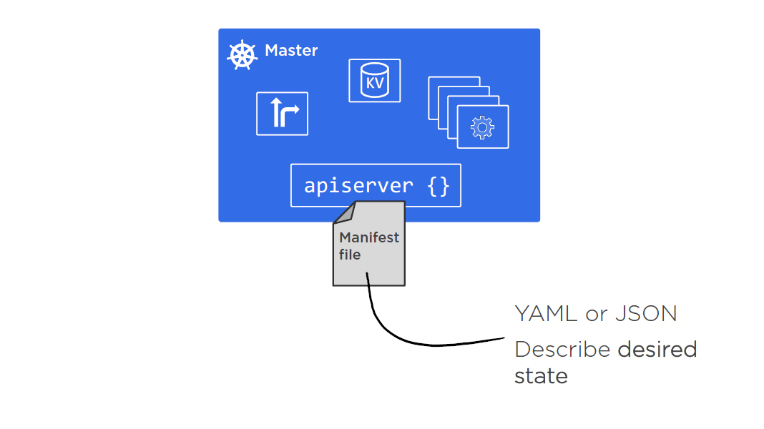

Slide 26
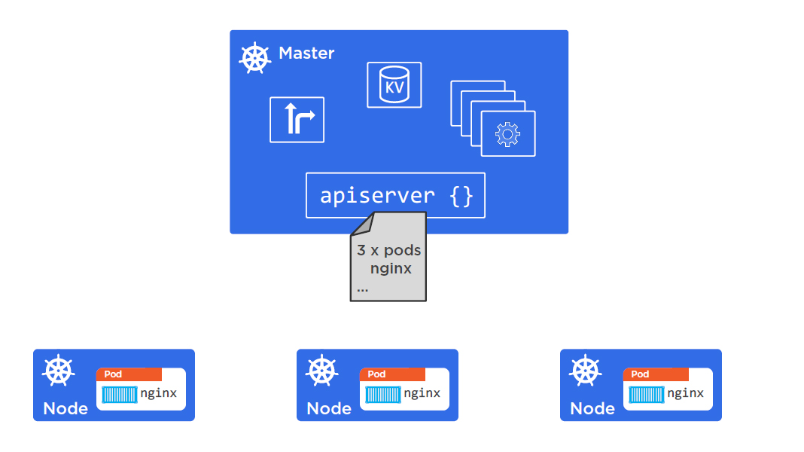

Slide 27
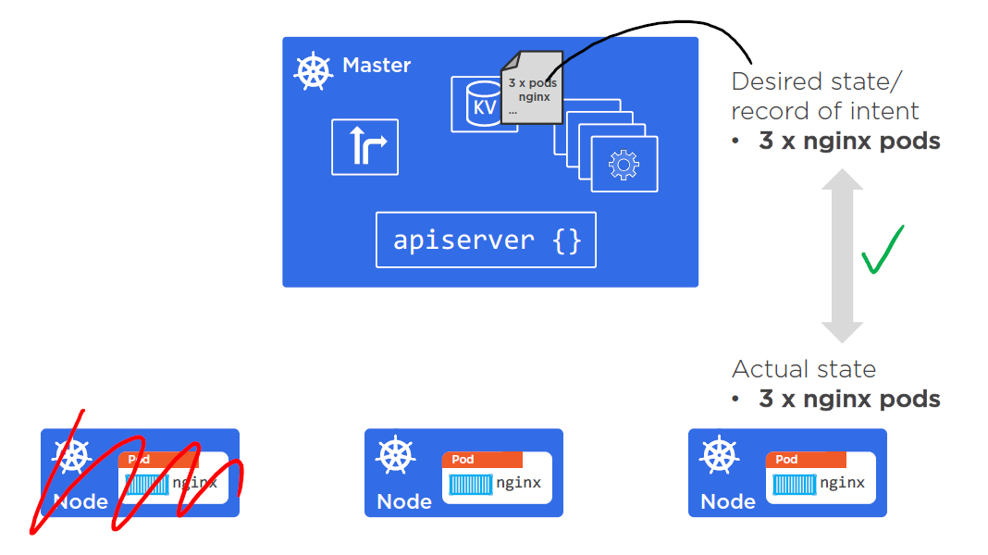

Slide 28
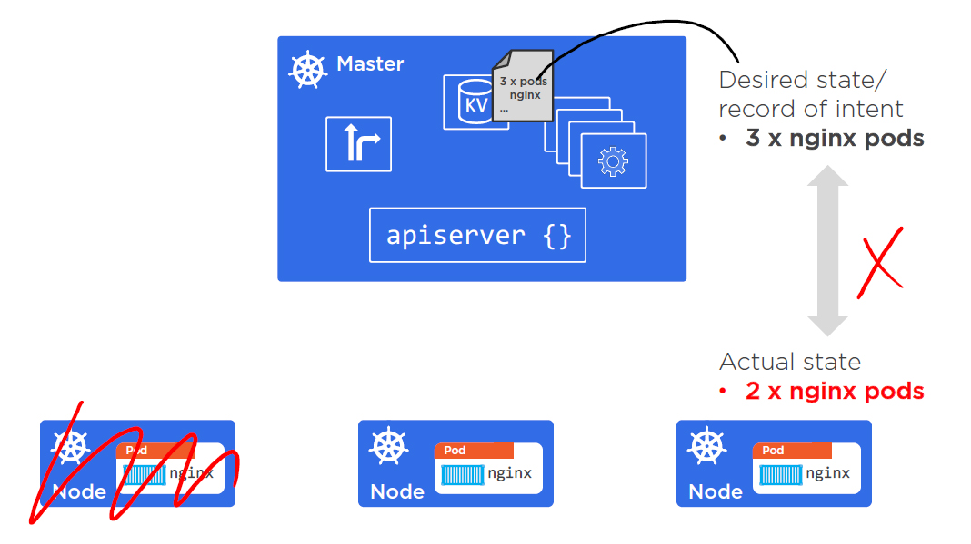

Slide 29
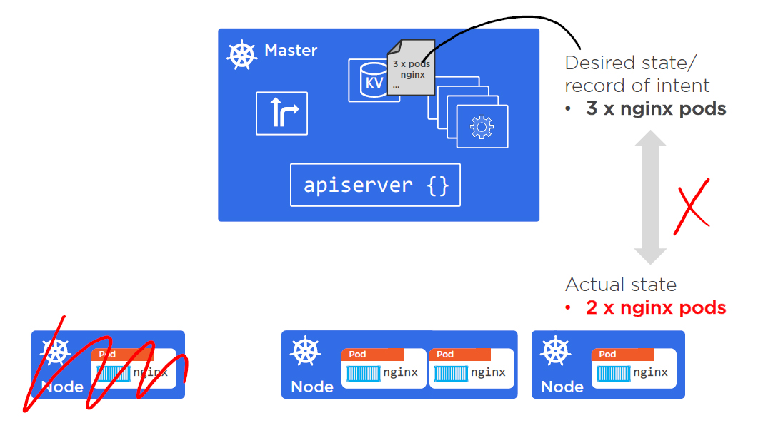

Slide 30


Slide 31
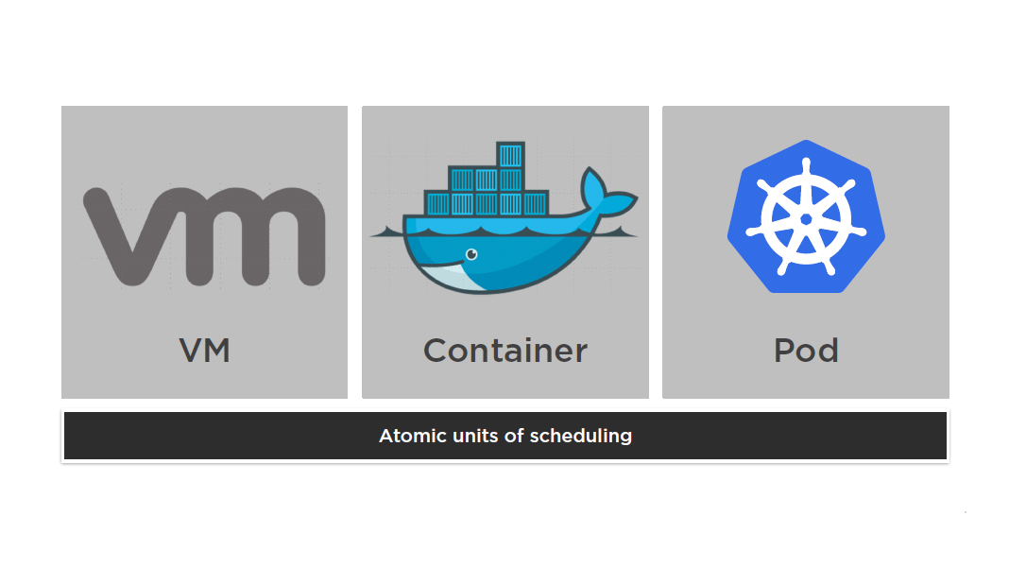

Slide 32
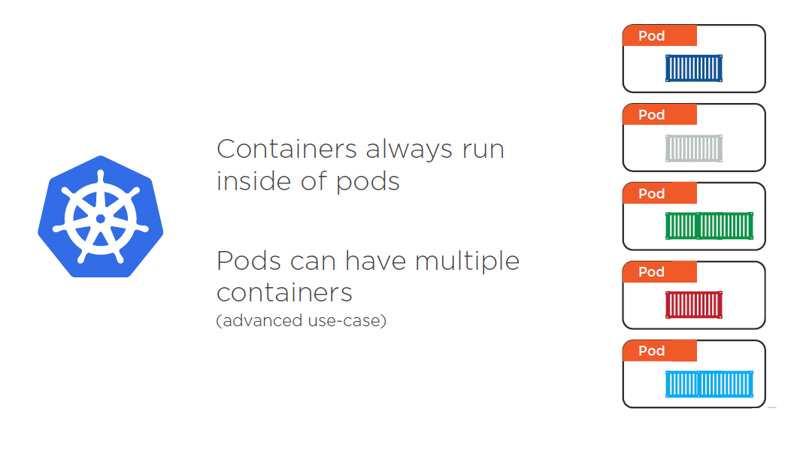

Slide 33
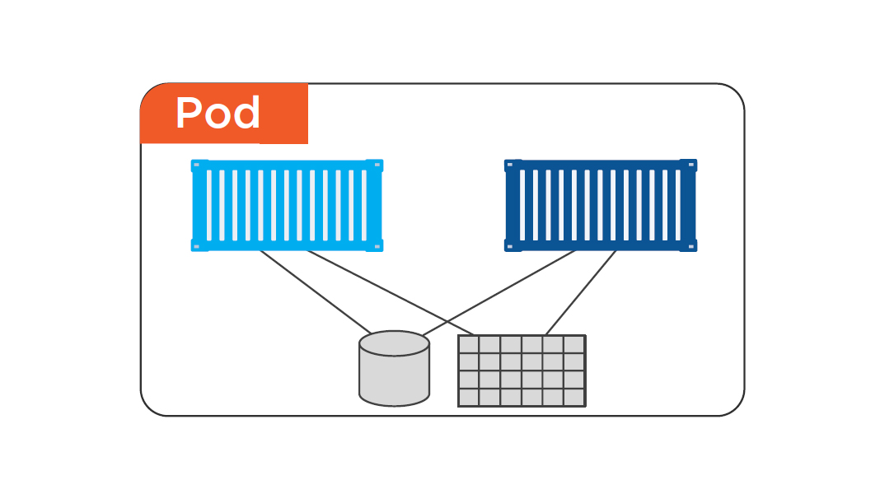

Slide 34
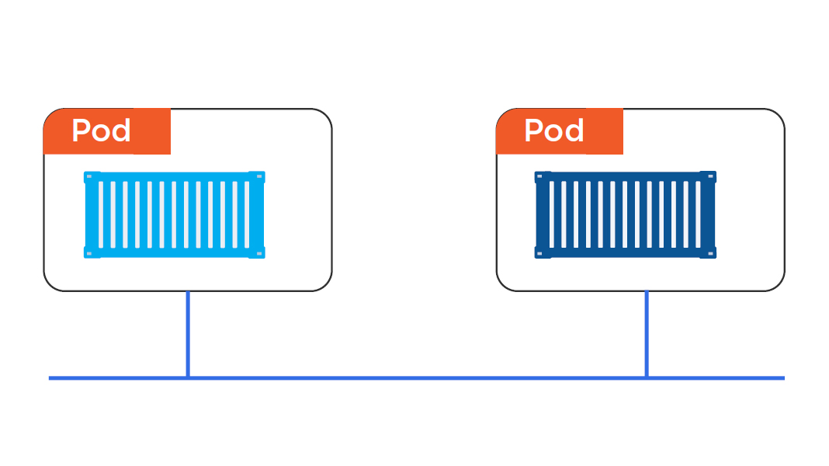

Slide 35
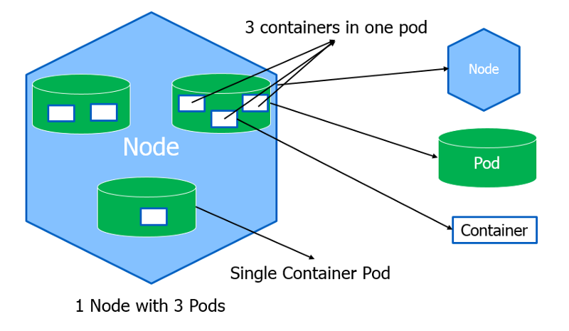

Slide 36
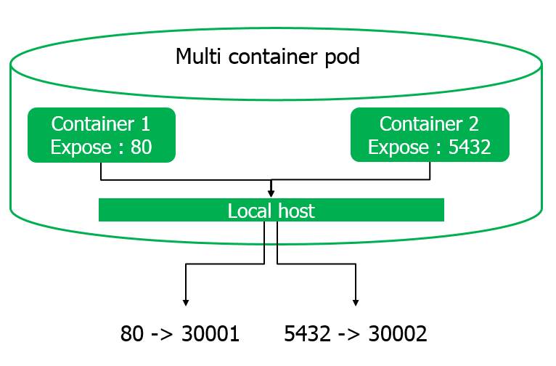

Slide 37
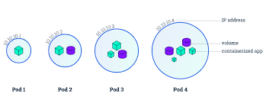

Slide 38
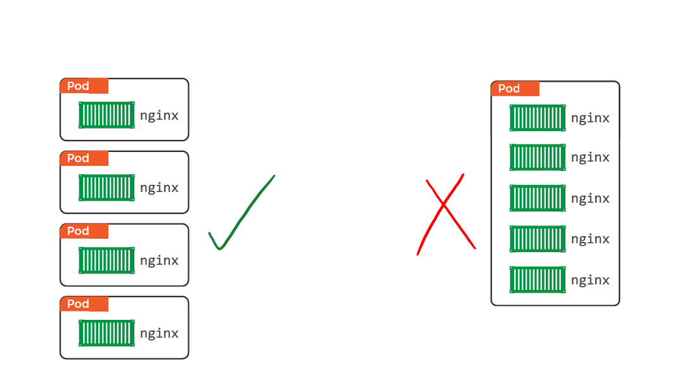

Slide 39
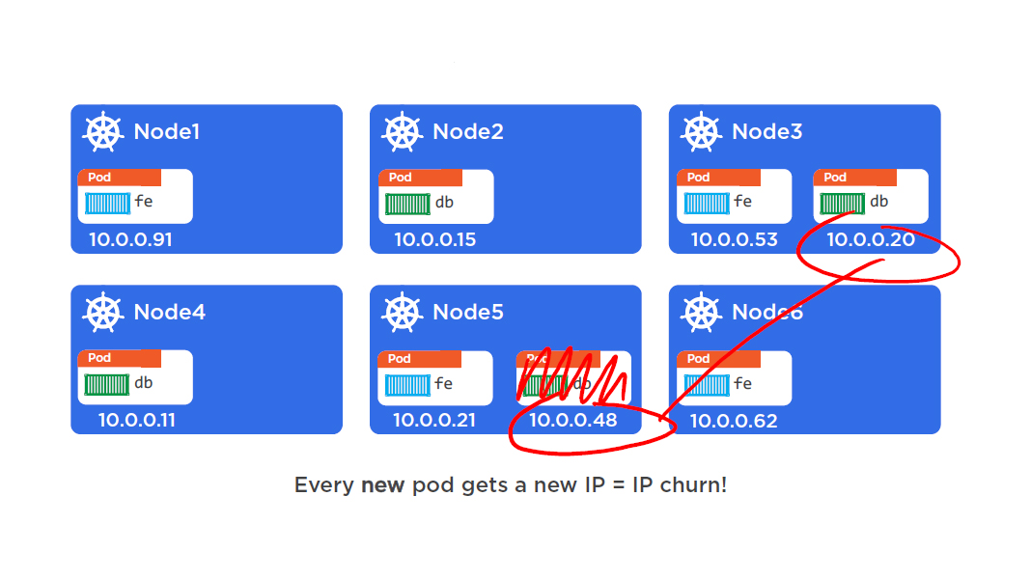
Service

Slide 40
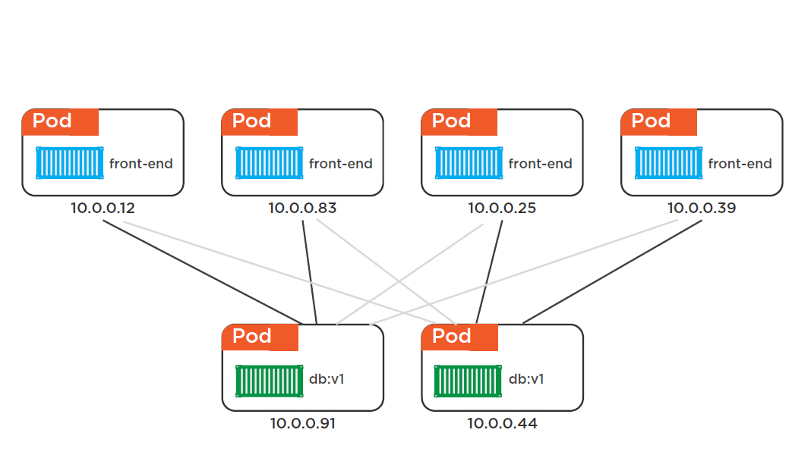

Slide 41


Slide 42
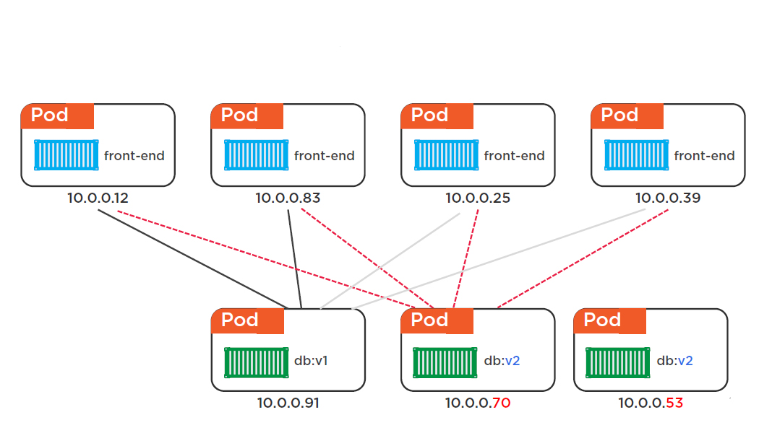

Slide 43
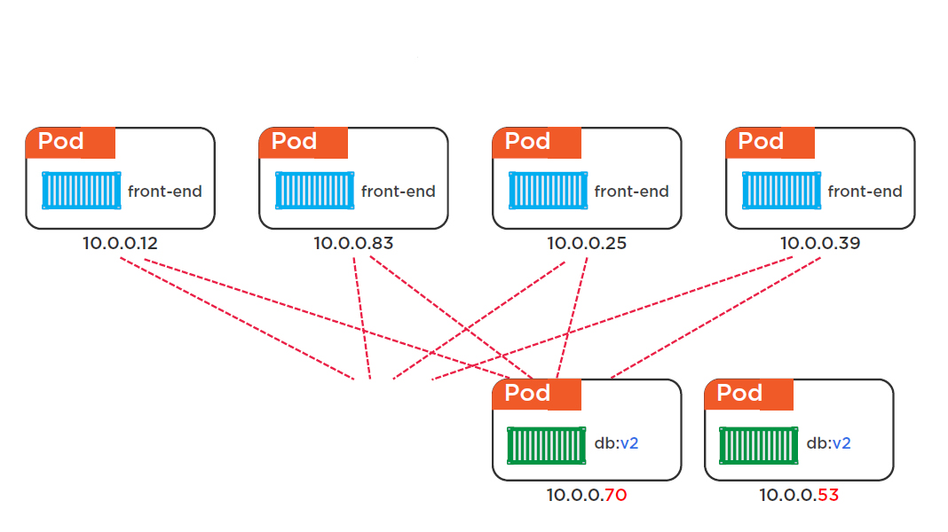

Slide 44
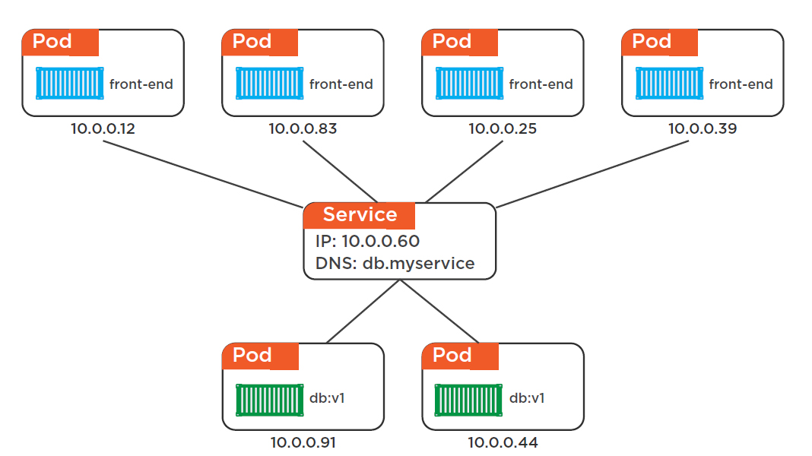

Slide 45
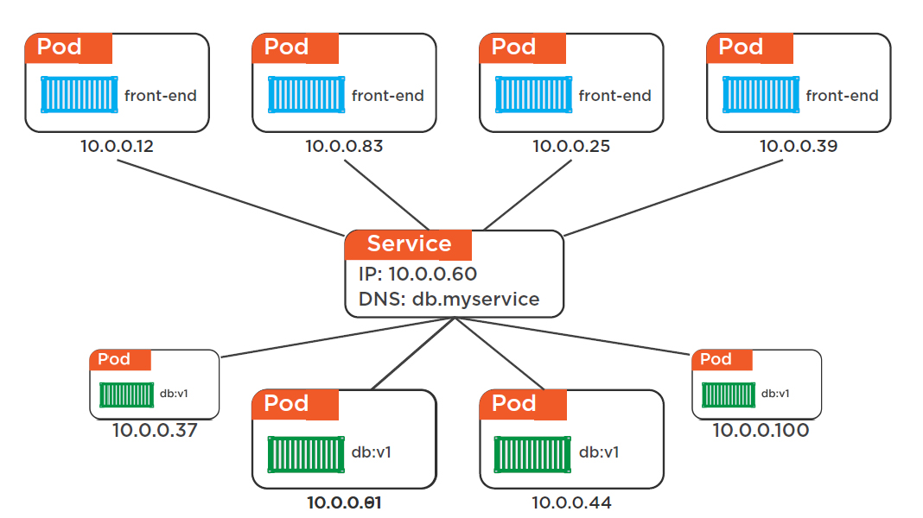

Slide 46
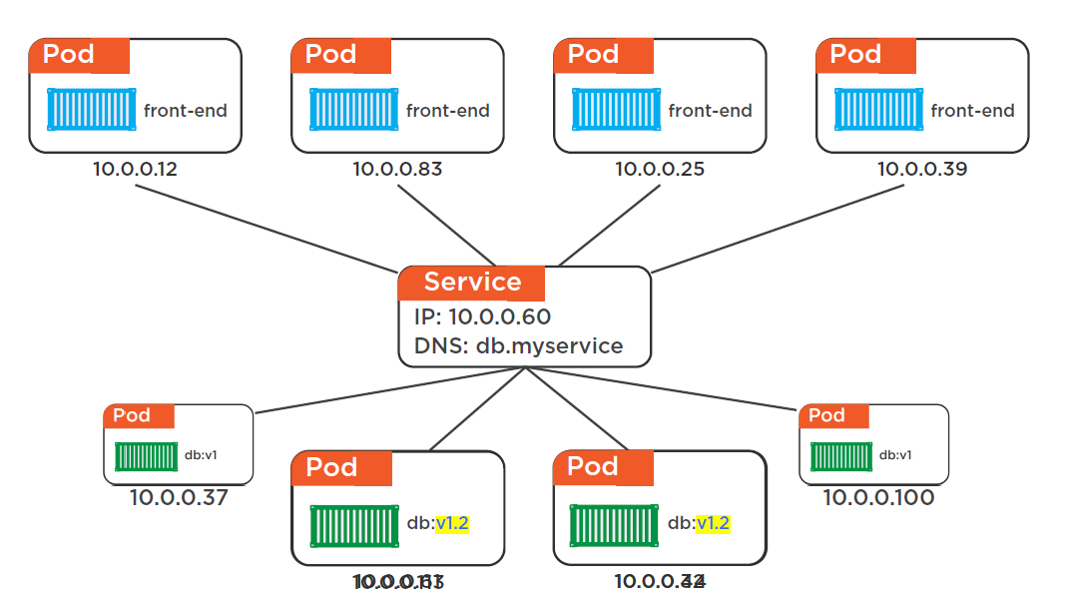

Slide 47
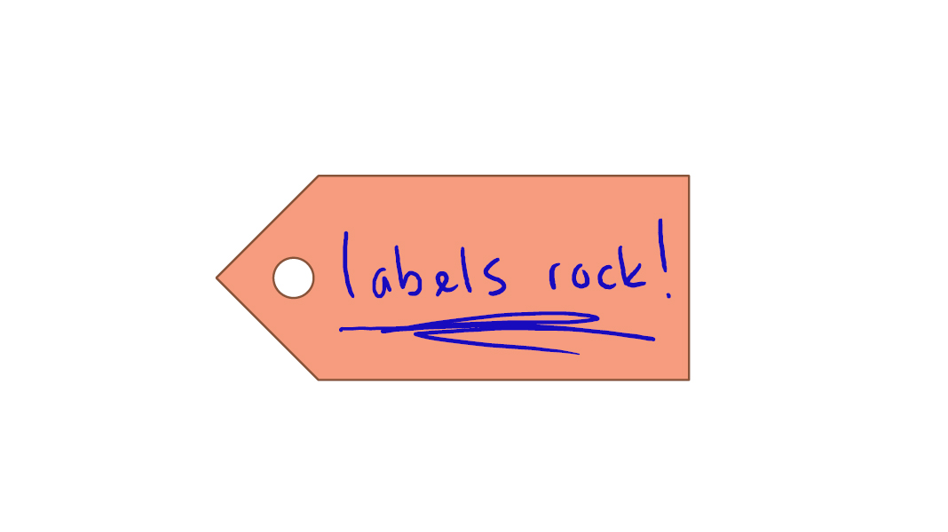

Slide 48
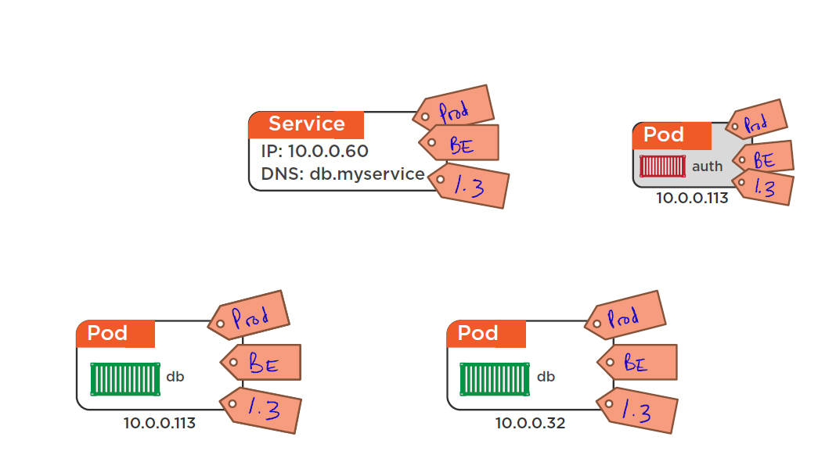

Slide 50
Pod Life Cycle
Api server (yaml)
Pending – Running – succeeded
Pending - failed

Slide 51
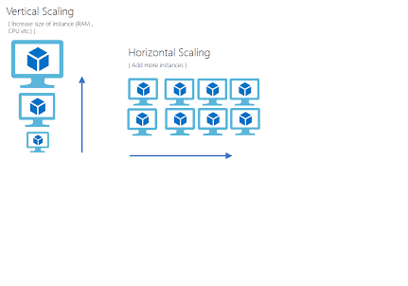

Slide 52
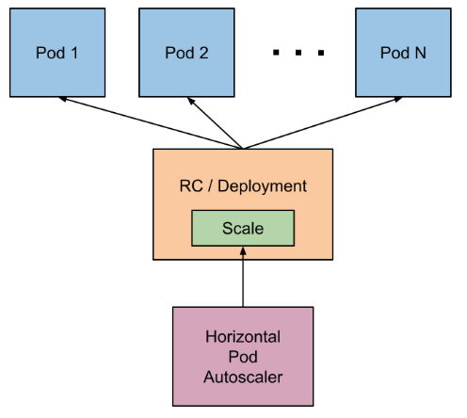

Slide 53
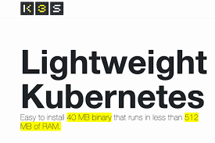


Slide 54
K3S
Linux 3.10+
512 MB of ram per server
75 MB of ram per node
200 MB of disk space
x86_64, ARMv7, ARM64

Slide 55
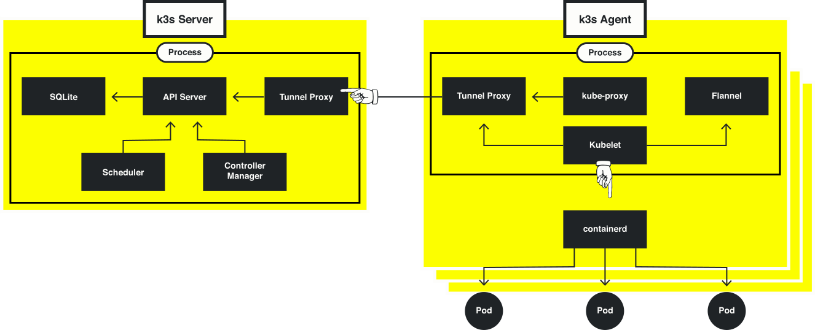

Slide 56
Playing with Kubernetes
http://play-with-k8s.com
Confirm you are human (docker account or github account)

Slide 57
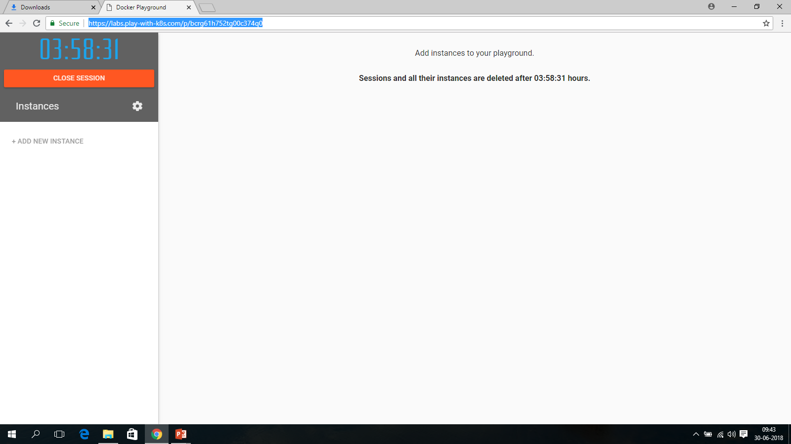

Slide 58
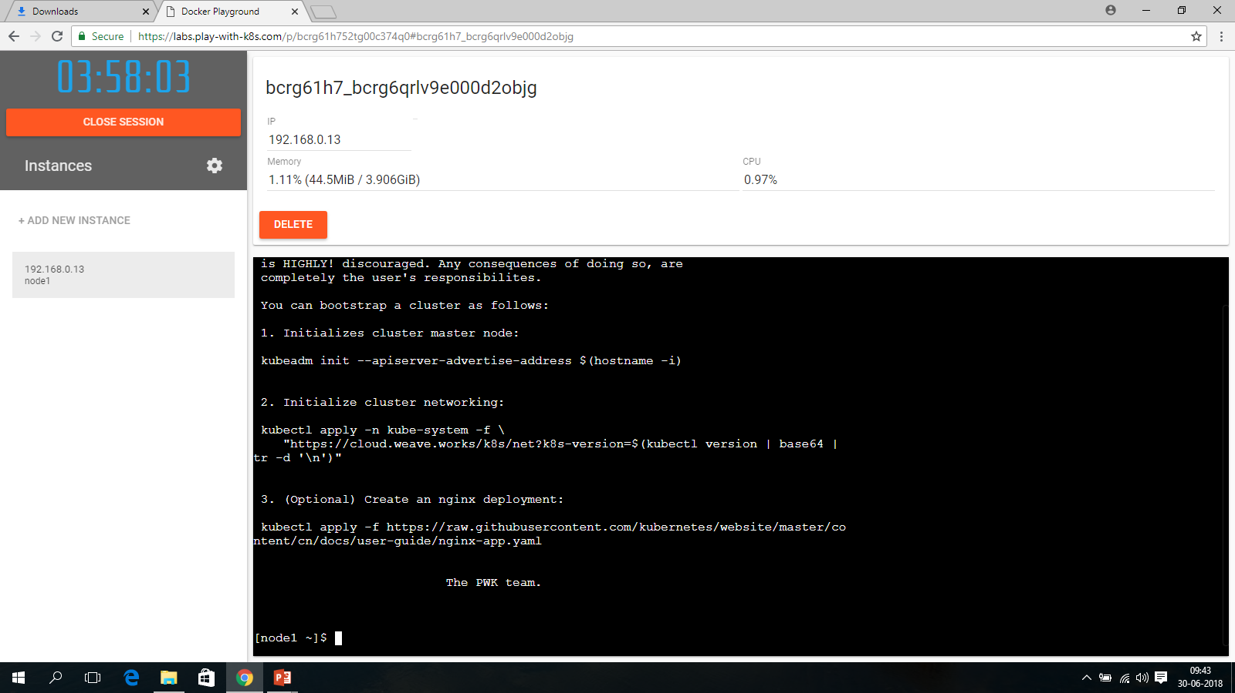
Add a new instance

Slide 59
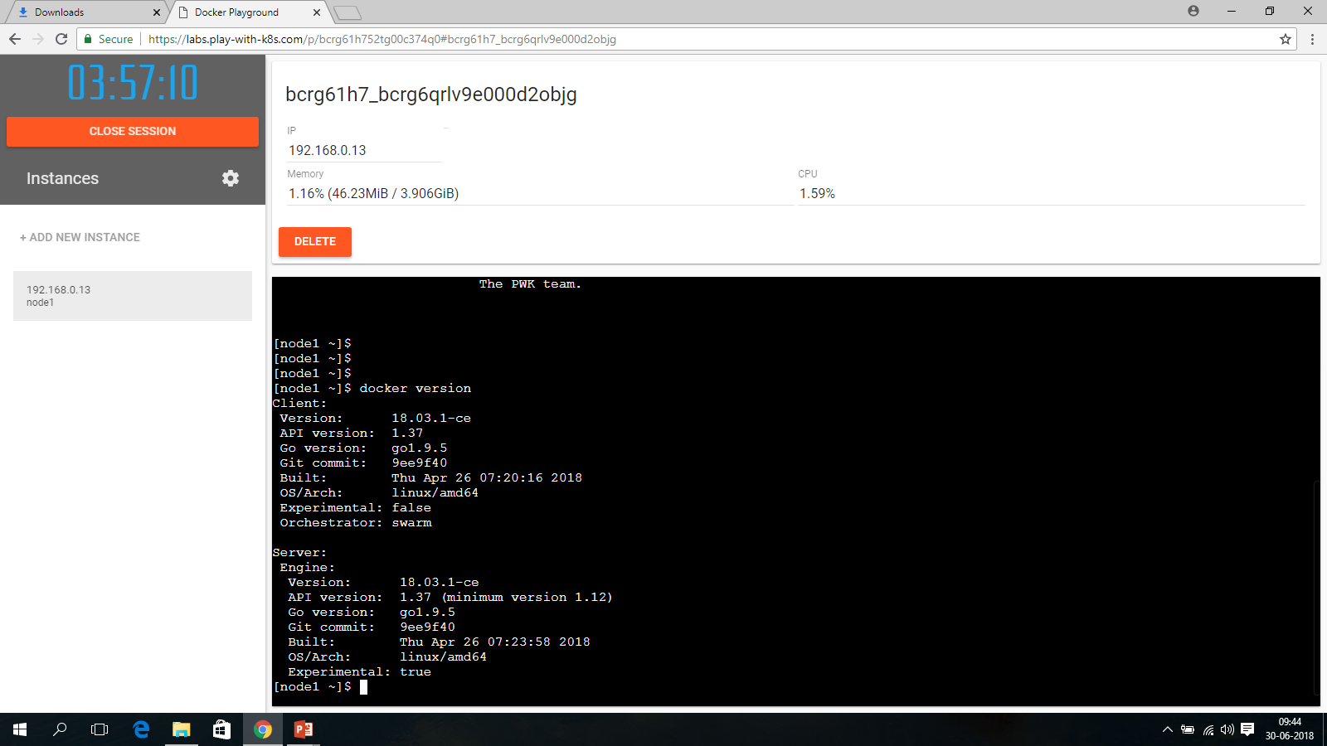

Slide 60
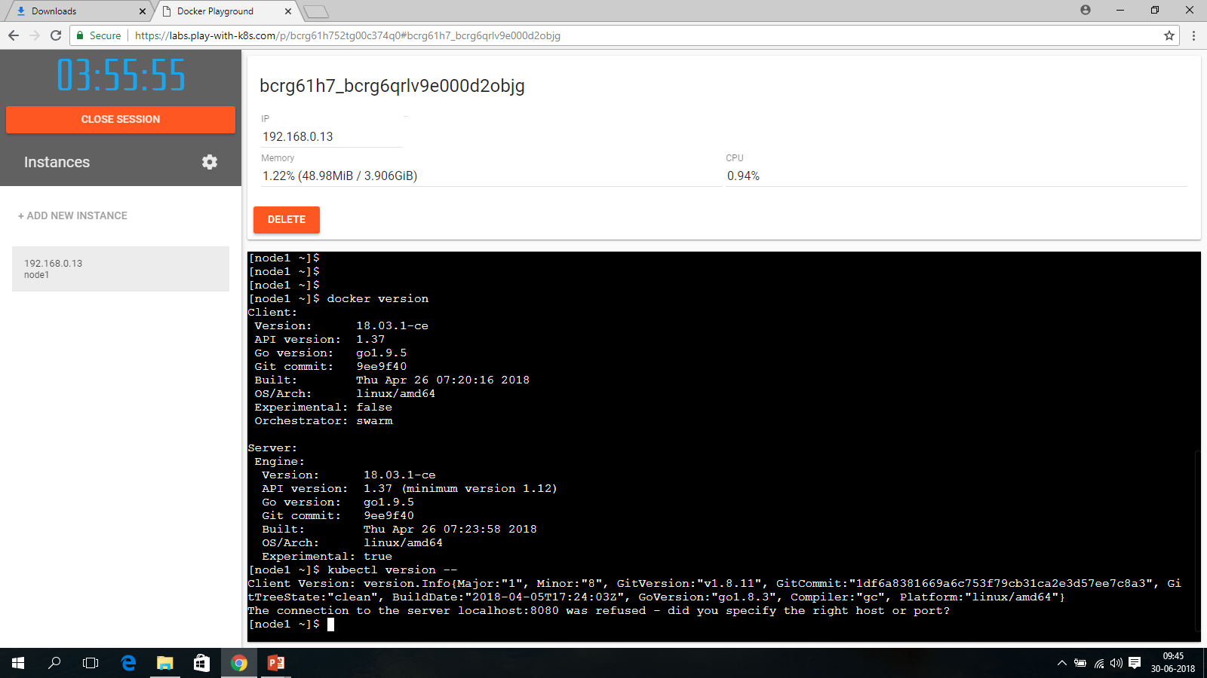

Slide 61


Slide 62


Slide 63


Slide 64


Slide 65


Slide 66


Slide 67


Slide 68


Slide 69


Slide 70

Networking

Slide 71


Slide 72

Kubernetes

Slide 73


Slide 74


Slide 75


Slide 76


Slide 77


Slide 78


Slide 79


Slide 80


Slide 81


Slide 82


Slide 83


Slide 84


Slide 85


Slide 86


